Slide 1



MCE-5 Machine Reliability
Juddson Raia

Slide 2
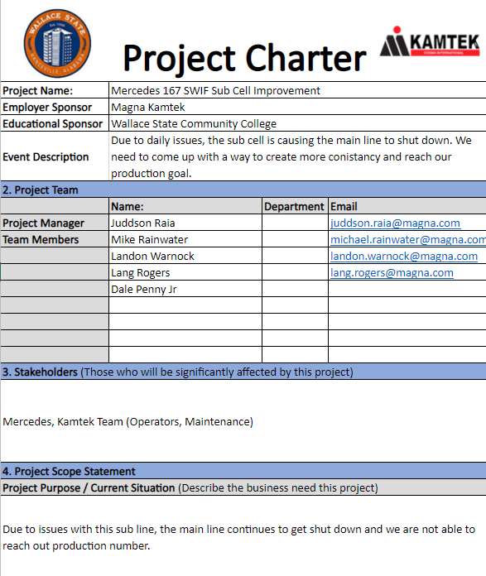
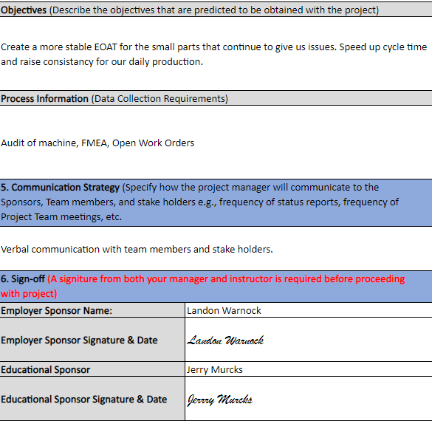

Charter

Slide 3
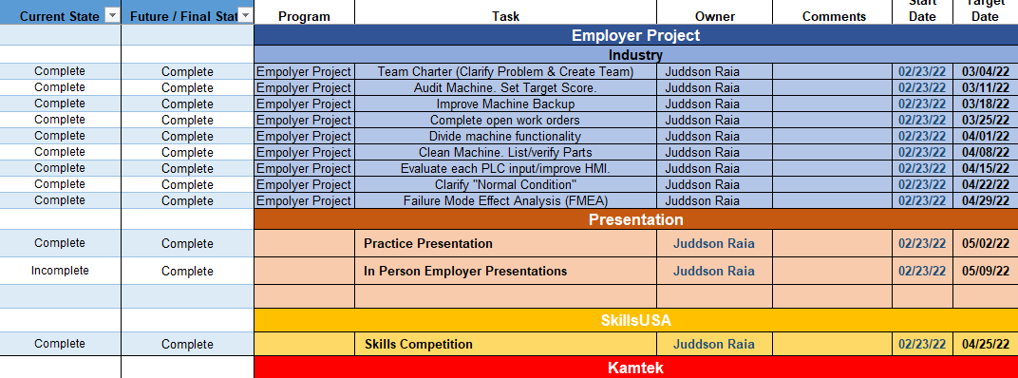
Gannt Chart

Slide 4
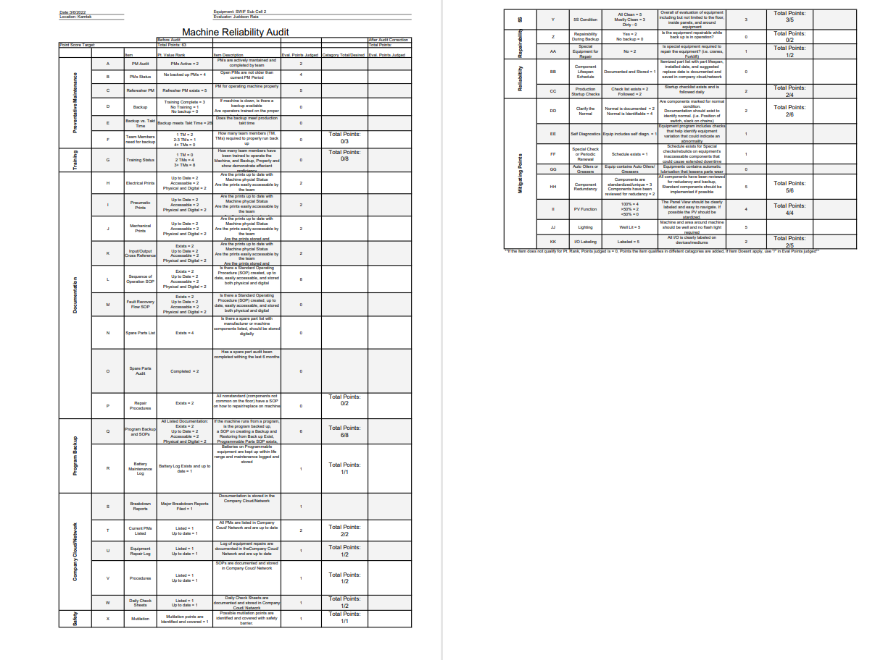
Machine Audit
Initial Score: 63
Target Score: 96

Slide 5
Improve Machine Backup
Make Sure Replacement electrodes stocked
1
Make sure replacements are stored close to the line
2
Verify critical information is labeled
3

Slide 6
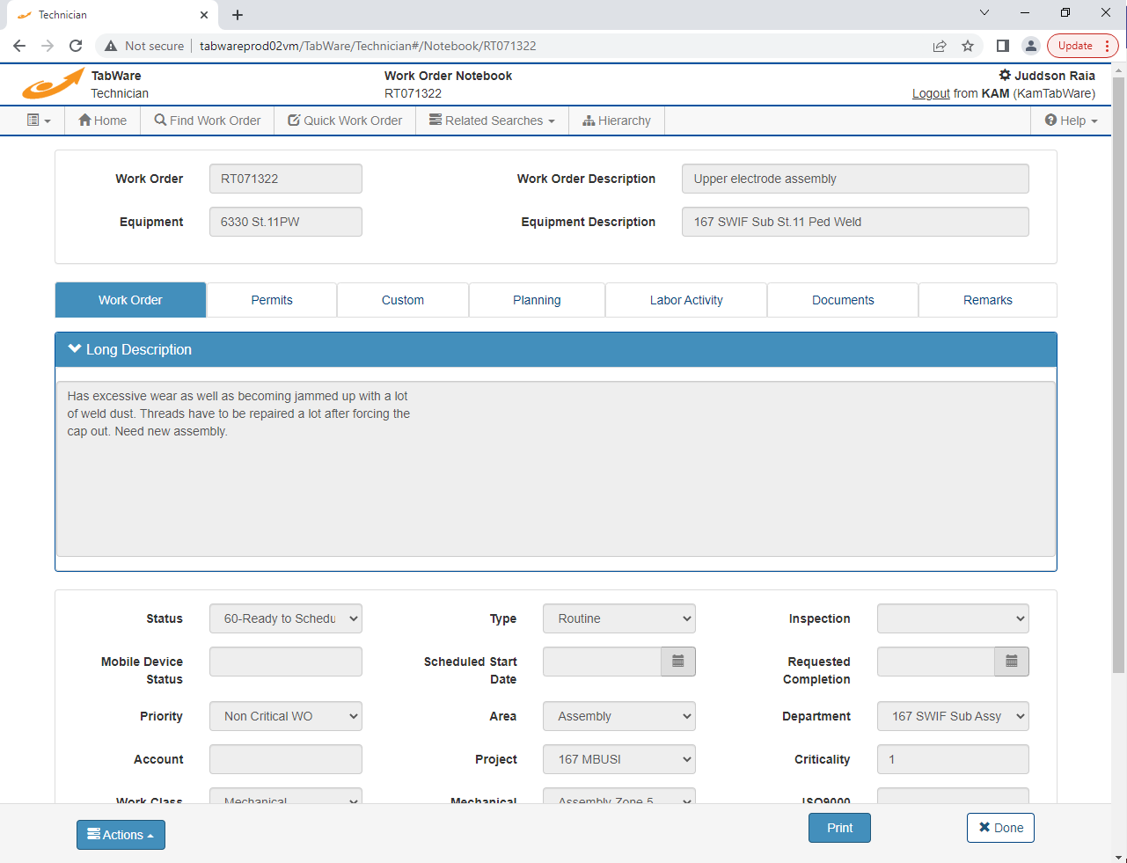
Open Work Orders
There was one open work order.
Performed task and closed out.

Slide 7
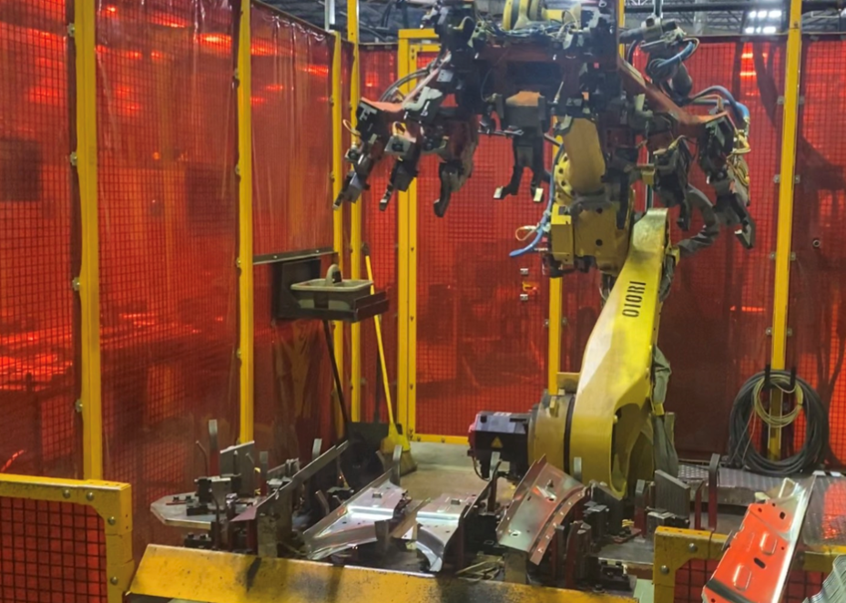
Divide Machine
Robot EOAT
Fanuc Robot
Load Station

Slide 8
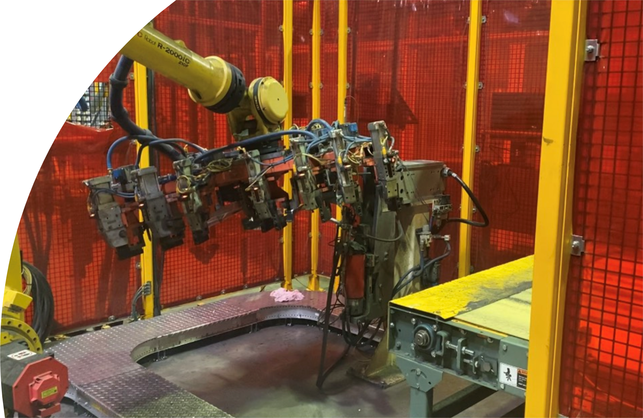
Divide Machine
Ped Welder
Conveyor

Slide 9
Clean Machine
Cleaned the machine in order to more easily locate problem areas.
Cleaned excess hardware off the floor in work cell.
Organized electrode replacement storage area.

Slide 10
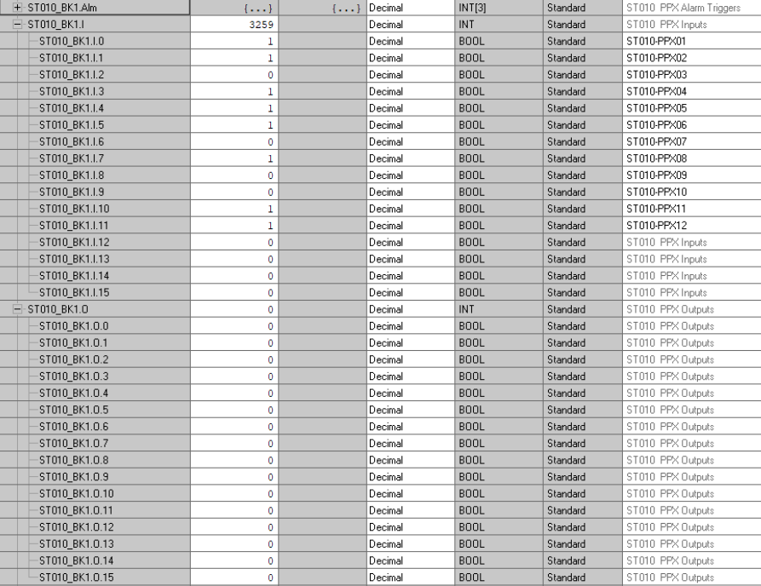
Machine I/O

Slide 11
Machine I/O
Verified replacements are available for all sensors as well as output devices. These included cables, sensors, clamps, and valves.

Slide 12
Clarify Normal Conditions
Electrodes have been replaced.
Verified the teach is sitting flush with the electrode.
Part present sensors are sitting at correct height so that it will not read when the part has slipped.
Hardware is not covering the floor due to misfeeds from ped welder.
Pressure of ped welder components are correctly set as marked on the device.

Slide 13

Questions and Answers

